Slide 1
Online Safety for parents and carers

Slide 2
How many of these apps can you Name?
Facebook
Tik Tok
Instagram
Snapchat
Discord
Twitter
Houseparty
WhatsApp
Omegle
YouTube
Messenger
Twitch

Slide 3
A growing digital age
Over ½ the world uses the internet
75 years
12 years
38 years
13 years
4 years
1 years
5 year
35 days
14 days
Higher or Lower - How long it took to reach 50 million users:
Phone
Mobile
Radio
TV
World Wide Web
YouTube
Facebook
Angry Birds
Pokémon Go
If you are over 45, you have seen the worlds population double
2.8 billion people use social media

Slide 4
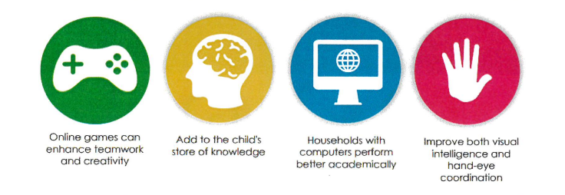
Positives of the internet
Outcomes for children are significantly improved if we use connected technology.

Slide 5
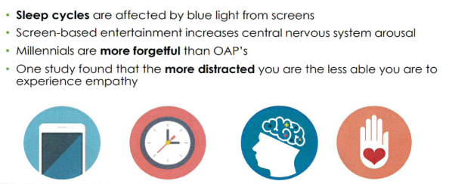
But technology can effect children’s development

Slide 7
Areas of focus
Inappropriate content
Inappropriate contact
Inappropriate conduct
Making things safer
Platforms

Slide 8
Inappropriate content

Slide 9
Actions
Set up parental controls on home broadband (check and set these up with your broadband provider)
Set up content lock on mobile networks (check and set these up with your mobile network provider)
Use safe search on browsers (child friendly browsers and search engines)
Ensure supervised use of the internet at all times
Check age ratings of apps – is the app appropriate

Slide 10
What to Talk about
Talk regularly about the internet and risks associated with using it
Ensure they know they can come to see you if they see anything that upsets them
The importance of respect for each other and the meaning of consent
The understanding that the internet permanently captures everything they do and this can affect them in later life
The law still applies online

Slide 11
The law

Slide 12
Inappropriate contact

Slide 13
What is inappropriate contact

Slide 14
Actions
Set up safe social media profiles that don’t share personal information
Turn off geo location settings on devices
Use the strongest privacy settings on social media
Learn how to report/ block/ mute
Set up restrictions on apps to ensure they can’t be added to group chats without their consent

Slide 15
What to talk about
Sometimes people hide behind fake profiles for dishonest reasons
Agree how they will respond to requests from people they don’t know in real life
Never ever to meet up with anyone they don’t know in real life

Slide 16
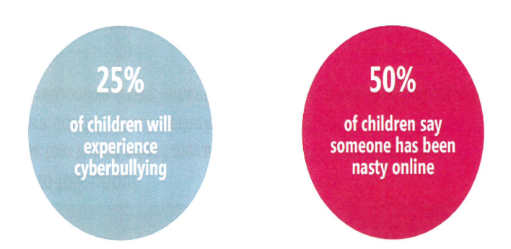
Cyberbullying

Slide 17
Cyberbullying

Slide 18
Grooming

Slide 19
Inappropriate conduct

Slide 20
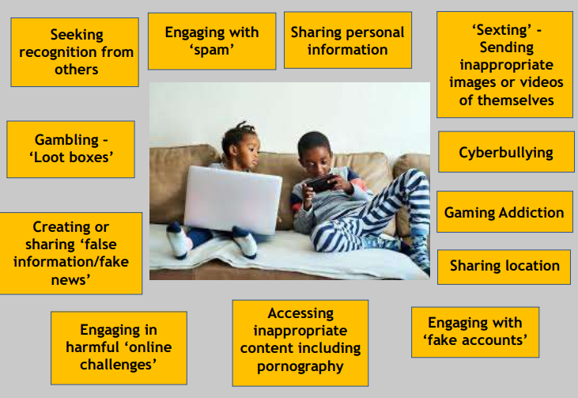
What is inappropriate conduct

Slide 21
Actions
Report inappropriate posts/ content to the social media providers
Think carefully about using monitoring apps that identify inappropriate behaviour – talk to your broadband and mobile provider for information about this

Slide 22
What to talk about
Talk to a trusted adult if they experience anything upsetting online
Think carefully about sharing images of others
Be responsible online, remembering they are creating their own digital footprint

Slide 23
Making things safer

Slide 24
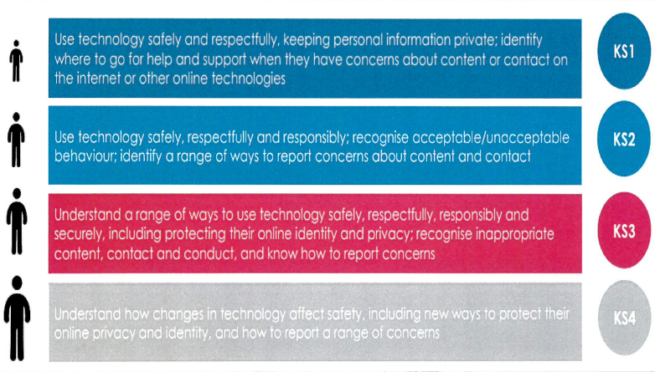
What is taught in school

Slide 25
Responding to concerns

Slide 26
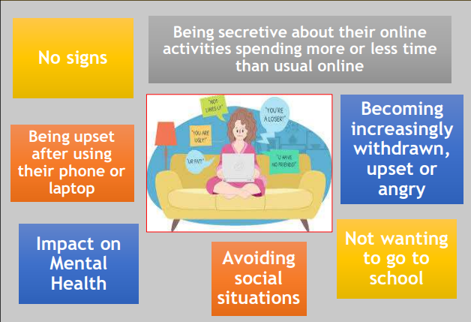
Signs a child may be experiencing harm online

Slide 27
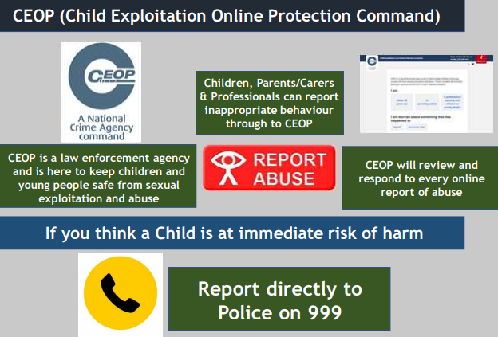
Reporting online behaviour

Slide 28
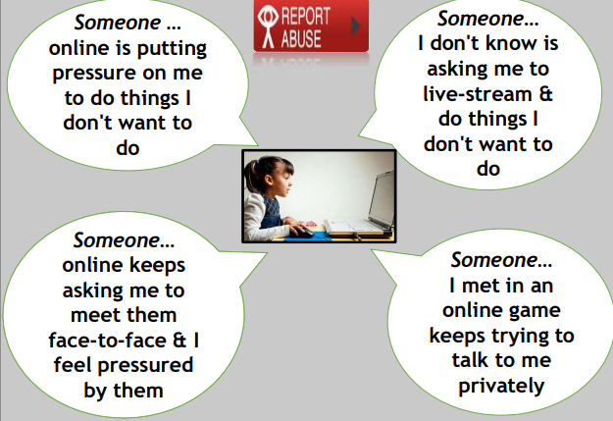
What should be reported to CEOP

Slide 29
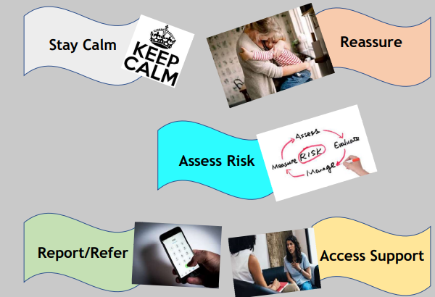
How to engage with your child about a concern

Slide 30
Screenshots

Slide 31
Safer internet

Slide 32
Monitoring online safety

Slide 33
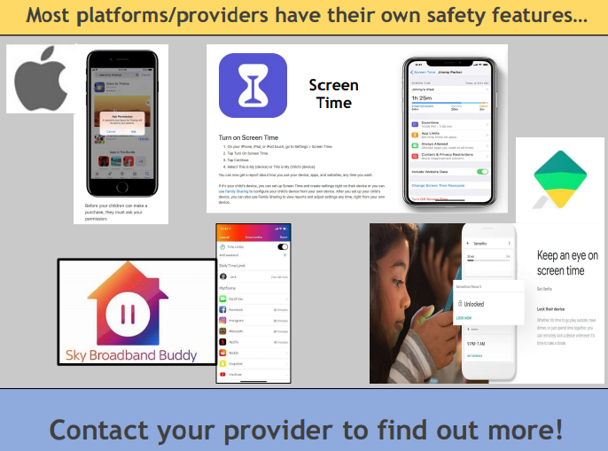
Safety features

Slide 34
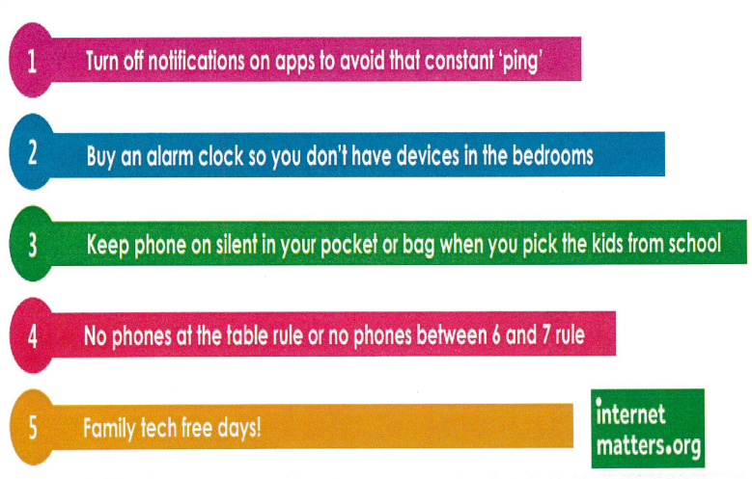
Controlling tech time
Your children will be watching the way you use technology and they will copy; make sure there is consistency in how you role model good behaviour.

Slide 35
Parental controls

Slide 36
NOS
Please find below the link you need to visit to register your account. You will need to complete your details and select “I am a: Parent/Carer” from the dropdown menu:
National Online Safety | Keeping Children Safe Online in Education
Once you have registered, you will be able to access the ‘Online Safety for Parents and Carers’ Course and National Online Safety’s Resources – Which include a wide range of online platform guides on the latest social media channels and games. National Online Safety release a brand-new guide weekly, and aim to cover all major social media platforms, apps and issues that children encounter online.

Slide 37
3 Key tips
Understand, accept and control the risks associated with the online world
Communicate regularly
Agree a ‘What if’ plan

Slide 38
Platforms

